Slide 1
Chronic Hypoventilation and Non-Invasive Ventilation
Khalid Ismail, MD
Director, Non-invasive Ventilation Clinic
Ambulatory Medical Director
Division of Pulmonary and Critical Care Medicine
Brigham and Women’s Hospital
Instructor of Medicine
Harvard Medical School

Slide 2
Khalid Ismail, MD
University of Alexandria School of Medicine
Internal Medicine Residency @ Northwestern University/St. Joseph Hospital
Pulmonary and Critical Care Fellowship @ NYU
Sleep Medicine Fellowship @ Lahey Clinic/Tufts Medical School
Instructor of Medicine @ Harvard Medical School
Joint appointment in Pulmonary/Critical Care, and Division of Sleep Medicine @ Brigham and Women’s Hospital
Ambulatory Medical Director, Pulmonary Division, Brigham and Women’s Hospital
Medical Director, Non-Invasive Ventilation Clinic, BWH
Former Director, Sleep Center, Tufts Medical School
American board certified in Internal Medicine, Pulmonary Medicine, Critical Care Medicine, and Sleep Medicine

Slide 3
Disclosures
I have no relevant financial or nonfinancial conflicts to disclose.

Slide 4
Case Presentation
A 49 year old female diagnosed with limb girdle muscular dystrophy, Titin mutation, on screening, back in 2014, when multiple siblings got diagnosed with the disease. She had minimal to no muscle weakness. (Titin mutation known to be associated with hereditary myopathy with early respiratory failure (HMERF)
In 2015, referred to pulmonary clinic, she had PFTs that suggested moderate restriction, at the time she was asymptomatic and active, and was then lost to follow up.
In 2018, she was admitted to the hospital with dyspnea and chest pressure, extensive work up including echocardiogram and chest CT were normal.
While hospitalized, Pulmonary team consulted, a PFTs showed restriction, and a drop in FVC from seated to supine position suggestive of diaphragmatic weakness. Muscle forces were severely reduced.
A morning ABG showed NO hypoventilation (7.41/44/112), bicarb 27. Pulmonary consult deferred starting NIV and recommended an outpatient sleep study, which eventually showed no significant sleep disordered breathing
Notes:
She has relatively mild proximal muscle weakness of which she does not seem to be symptomatic. Genetic testing has revealed a mutation in the titin gene as the most likely cause of her myopathy). We explained the results of the genetic test to her. Although she is currently asymptomatic, her PFTs are abnormal and we know that titin mutations can be associated with Hereditary Myopathy with Early Respiratory Failure (HMERF) as evident in her siblings. So we need to watch her closely in this regard.
When seen in March 2015, we ordered next generation sequencing on her and her affected sister, Caroline, as there other affected sister, previously had testing that showed a possible mutation in the TTN that encodes for titin. Her genetic testing revealed sequence change in the titin gene at exon 291: 291 c.[87430T> C] p.Cys29144Arg. This sequence change was listed in the report as being of unclear significance in the initial testing of her sister, but was subsequently reported in her testing as being pathogenic. This mutation is actually the one that has been identified in all 3 sisters.
CK were 382 in March 2015.
We also ordered Pulmonary function test that were performed in April 2015:
FEV1 and FVC are reduced, FEV1/FVC is normal. TLC is decreased. FRC is
normal. RV is normal. RV/TLC ratio is increased. Single breath diffusion
capacity is reduced. The patient did not appear to complete a full
expiratory maneuver on spirometry, which would artificially decrease the FVC
and increase the FEV1/FVC. However the reduction in TLC demonstrates a
moderate (TLC between 60 and 69% of predicted) restrictive ventilatory
deficit. The reduction in DLCO, which is corrected when taking into account
VA, may suggest an extraparenchymal abnormality contributing to the
restrictive process.
Pulmonary visit:
PFTs: ‎4/2/15
FVC (Lts) 1.62 46%
FEV1 (Lts) 1.44 48%
TLC (Lts) 3.30 64%
VC (Lts) 1.70 48%
RV (Lts) 1.60 101%
DLCO Unc (mL/min/mmHg) 12.28 48%
DL/VA (%) 5.53 110%
Assessment & Plan:‎‎‎
40yo F who presents for evaluation of titin muscular dystrophy. She is definitely at risk for early respiratory failure as seen by many of her 1st degree relatives. Fortunately, she is currently asymptomatic and does not appear to have any functional limitations. However she has clear restrictive findings on PFTs with low lung volumes and low DLCO that corrects with VA. We will need to review her sleep study to assess for any nighttime hypoventilation and hypoxemia. It was reportedly normal which is reassuring. At present, we do not see any clear indication for O2 supplementation or NIPPV as of yet, however her symptoms and lung volumes will need to be followed closely.

Slide 5
Case Presentation
In 2019/2020, inhaled steroids were added, for possible reactive airway disease (RAST positive for multiple environmental allergies).
Because of persistent dyspnea, she was stepped up to a LABA/ICS.
PFTs continued to show restriction.
An overnight oximetry shows no significant nocturnal desaturation
ABG 7.40/42/100, bicarb 26-29
In April 2023, repeat PFTs showed a 35% drop in FEV1, and 28% drop in FVC
Overnight oximetry; time spent < 88% 11 minutes
ABG, 7.40/49/92, bicarb 30
She is started on home NIV (Astral device, iVAPS) as an outpatient
Notes:
Assessment & Plan:‎‎‎ 43yo woman w/ hereditary myopathy 2/2 titin mutation (exon 291, c.[87430T> C] p.Cys29144Arg) c/b restrictive lung disease who presents for inpatient follow-up evaluation of dyspnea and chest tightness. Her history of intermittent, self-limited dyspnea stimulated by identifiable triggers is most c/w undiagnosed asthma. In fact, her PFTs do reveal severe obstruction w/ an FEV1 of 43% of predicted. This is further substantiated by her FH of asthma and personal history of atopy. DDx of less likely causes include EGPA (unlikely w/ normal Eos), COPD (unlikely as non-smoker), CHF (not volume overloaded, TTE wnl), or endobronchial pathology. Given her history of titinopathy, however, an important consideration is cardiac ischemia. She is being followed by Dr. Coggins of Cardiology (cc'd here) and is being evaluated for arrhythmia as well as for ischemia via a stress test. Will defer further cardiac evaluation to him. Given the severity of her symptoms (1-2 nighttime awakenings/week and daily symptoms), will start w/ an ICS/LABA combination and SABA prn.
Regarding her neuromuscular weakness, her PFTs do reveal profound diagphragmatic weakness with decreased MIP and significant decreases in FEV1 and FVC when supine. This study, however, is confounded by the fact that she was complaining of abdominal pain at the time and admitted that she did not give her full effort. Regardless, she has a known NMS, and a restrictive ventilatory deficit. At this time, however, she does not qualify for nocturnal NIPPV given that her AM ABG did not reveal respiratory acidosis nor did she desaturate during o/n oximetry in the hospital. Furthermore, a recent sleep study (scanned into "Media") revealed an AHI < 5, arguing against OSA or central apnea. The plan moving forward, therefore, will be to monitor for progression q6months with full PFTs and follow-up examination.

Slide 6
Case Presentation
In 6/2023, she was diagnosed with a Pituitary microadenoma s/p transsphenoidal pituitary resection and had to hold NIV for 2 months. She used nocturnal oxygen instead.
Trouble tolerating her NIV. Complains of significant abdominal pain.
In March 2024, she is admitted to Brigham and Women’s Hosptial with acute on chronic hypercapnic respiratory failure, (bicarb 41) ABG:7.27/99/161, after 30 minutes of NIV; ABG 7.18, so she was intubated.
Extubated to BiPAP, and eventually back on her home device, Astral, iVAPS mode. Adjustments in settings to allow for increased Ventilation were not tolerated while in-patient, so plan was to gradually adjust as an outpatient.
Discharge ABG: 7.36/66, bicarb 36
April 2024, readmitted with acute on chronic hypercapnic respiratory failure (7.30/89, bicarb 41)
She was admitted to the ICU and started on NIV
Now being considered for long-term tracheostomy and home mechanical ventilation.

Slide 7
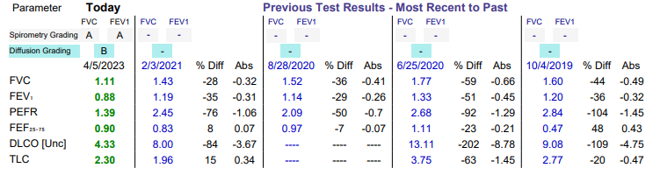
Case Presentation
Challenges managing patients with chronic hypercapnic respiratory failure
- Despite a compatible diagnosis back in 2014, respiratory failure progressed on our watch
- Lack of guidance on how to screen or how often
- Lack of guidance on when to initiate treatment
- Lack of guidance regarding best treatment options
- knowledge gap regarding specific treatment modalities
- Challenges with adherence and vent synchrony
4/5/23
PFTs: ‎4/2/15
FVC: 1.62 (46%), FEV1: 1.44 (48%)
TLC: 3.30 (64%)
DLCO Unc 12.28 (48%)
DL/VA (%) 5.53 (110%)

Slide 8
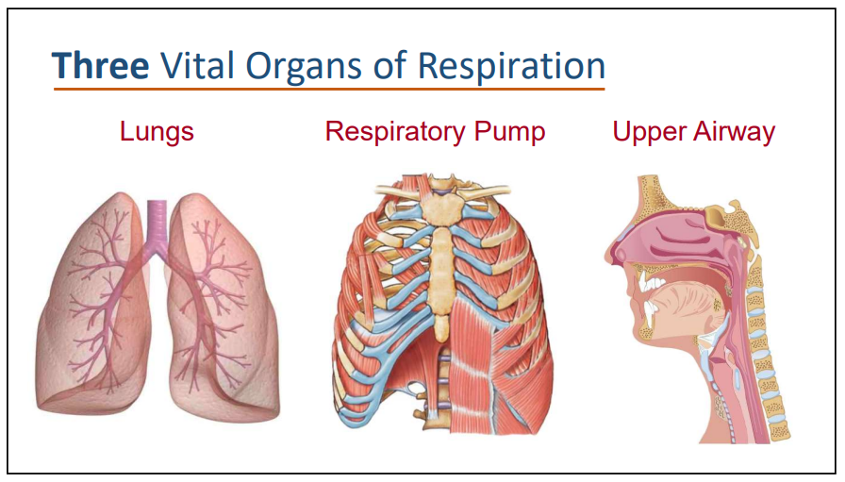
John Hansen-Flaschen, MD, Penn Medicine

Slide 9
Outline
Basics of Ventilation control and hypoventilation
Sleep impact on normal respiratory physiology
Consequences of chronic hypercapnia
Basics of chronic Non-invasive Positive Pressure Ventilation (NIPPV).
Chronic hypercapnic respiratory failure and NIPPV in special patient populations:
    Obesity Hypoventilation Syndrome (OHS).
    Neuromuscular disease (NMD).
    Stable hypercapnic COPD.

Slide 10
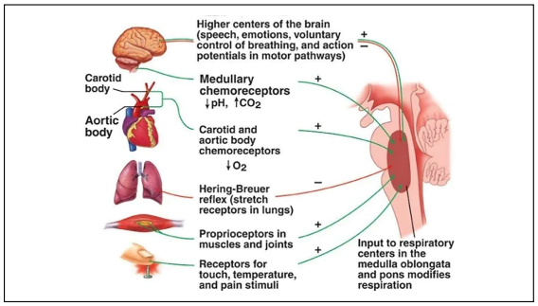
Control of Ventilation - Input
John Hansen-Flaschen, MD, Penn Medicine

Slide 11
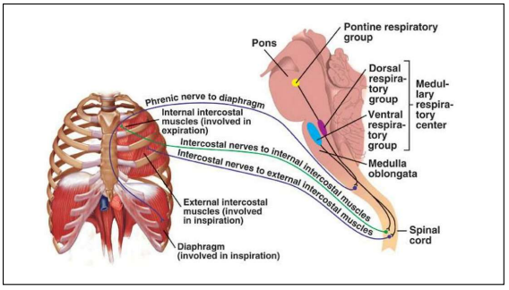
Control of Ventilation - Output
John Hansen-Flaschen, MD, Penn Medicine

Slide 12
Hypoventilation
Decreased central drive:
  Functional:
    Drugs (sedatives, narcotics), Metabolic (Low K, Mg, & Phosphate, metabolic alkalosis)
  Structural
    Stroke, trauma, neoplasm
  Idiopathic
    Primary alveolar hypoventilation (including OHS)
Altered neural and neuromuscular transmission:
  Neuropathies (Spinal cord injury, Guillain-Barré syndrome, Polymyositis, ALS, diaphragm paralysis)
  Neuromuscular junction (Myasthenia Gravis)
Muscle abnormalities: (muscular dystrophy, disuse atrophy)
Chest wall and pleural abnormalities (Kyphoscoliosis, thoracoplasty, OHS)
Airway obstruction
  Upper airway: (OSA/OHS, tracheal stenosis, tonsillar hypertrophy)
  Lower airway: COPD
Parenchymal lung disease (Interstitial lung disease, surgical resection)
Pump Failure
Airway and Parenchymal Disease

Slide 13
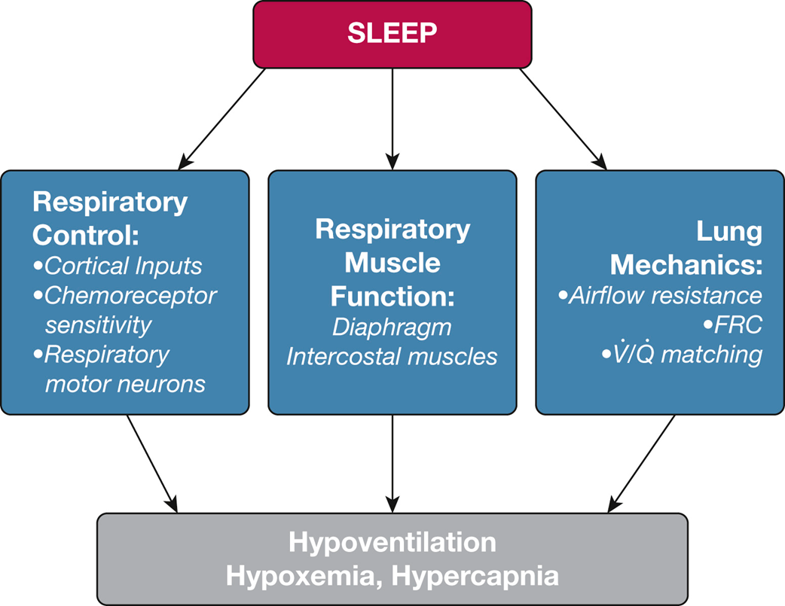
Walter T. McNicholas, MD, FCCP. CHEST 2017; 152(6):1318-1326

Slide 14
Respiratory changes during Sleep
↓ in hypoxic and hypercapnic ventilatory response 20-30%
↓ in minute ventilation 0.5-1.5 L
↓ PaO2 3-10 mmHg
↑ PaCO2 2-8 mmHg
↓ SaO2 2-4%
↑ in upper airway resistance
Mohsenin, Semin Resp Crit Care Med 2005

Slide 15
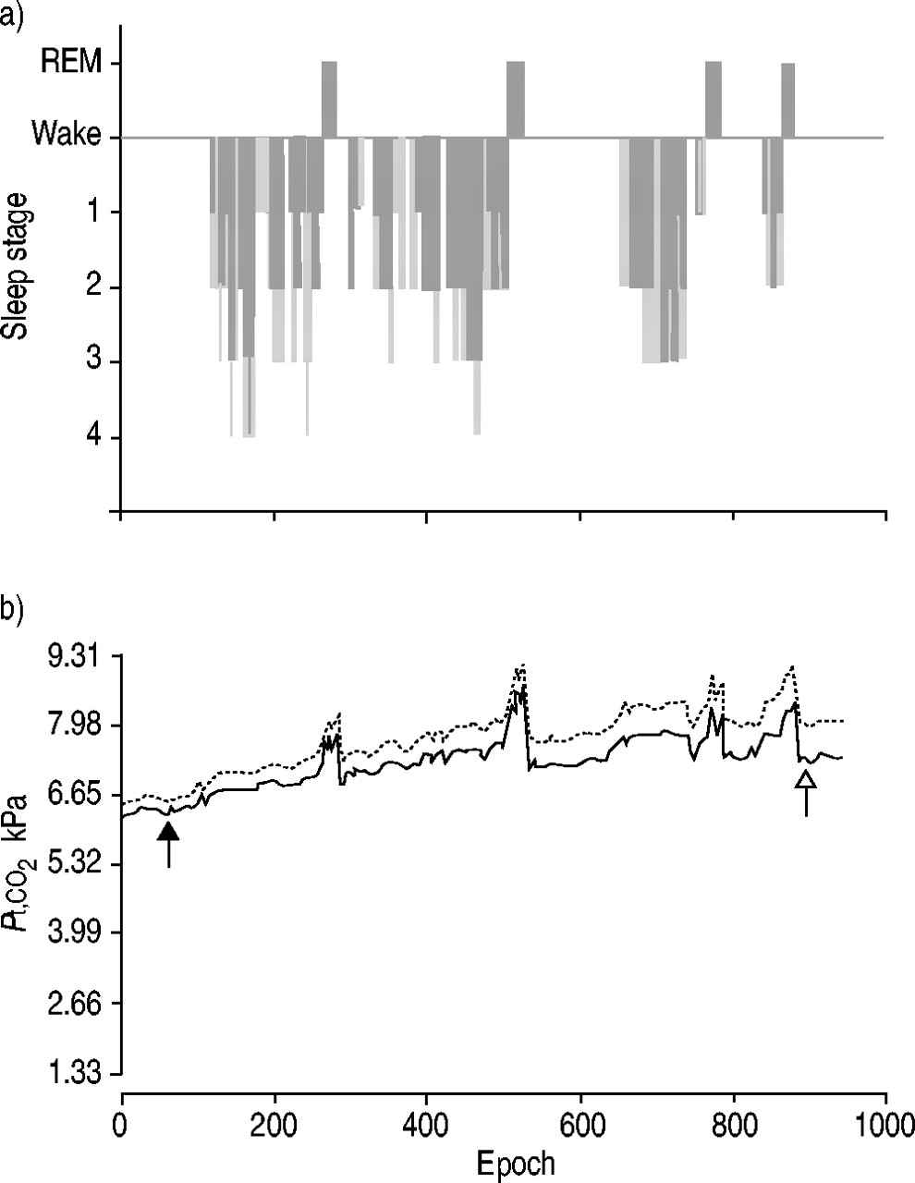
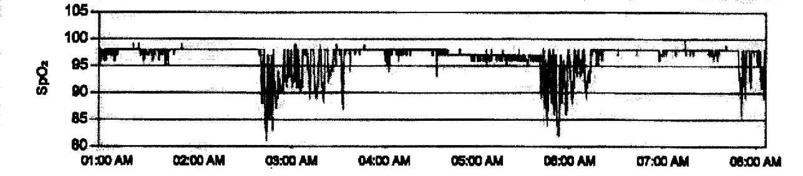
Consequences of REM-atonia
a) Sample hypnogram and b) transcutaneous carbon dioxide tension (Pt,CO2) record illustrating Pt,CO2 corrections.
F.J. O'Donoghue et al. Eur Respir J 2003;21:977-984
Notes:
An elevation in nocturnal TCO2 of > 10 mmHg to a TCO2 of >50 for > 10 minutes, defines nocturnal hypoventilation. It does predict daytime respiratory failure within 12 months of this finding.

Slide 16
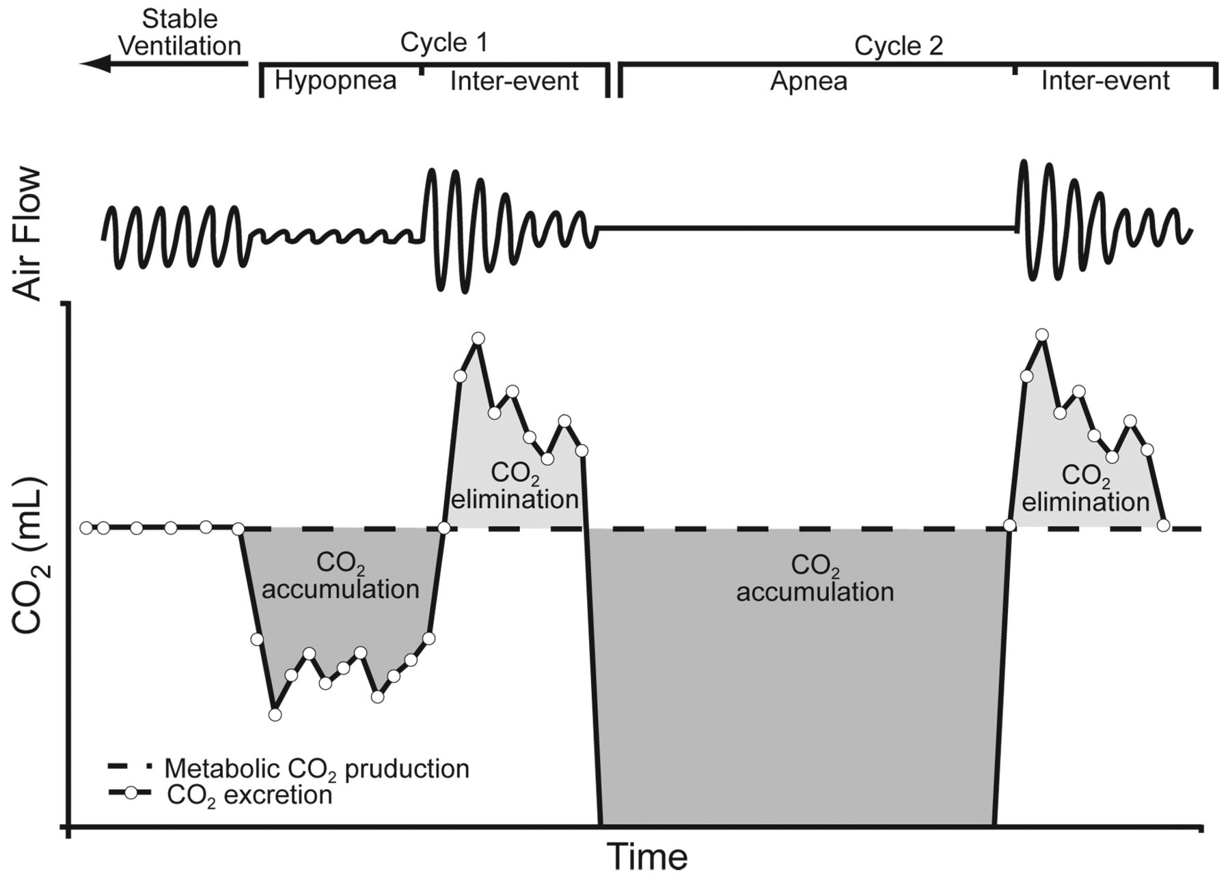
Obstructive Sleep Apnea and Hypoventilation
Berger et al. J Appl Physiol 2000;88(1):257-264
Notes:
Schematic demonstrating how CO2 excretion is dependent upon inter-event hyperventilation. In the first cycle, the inter-event hyperpnea is sufficient to excrete the CO2 accumulated during the hypopnea. In the second cycle, much more CO2 is accumulated during the apnea than is excreted after the event. Repetitive cycles of inability to eliminate CO2 accumulation during the apneic period leads to CO2 retention and increase in PaCO2 level. (Adapted from Reference 89, with permission.)

Slide 17
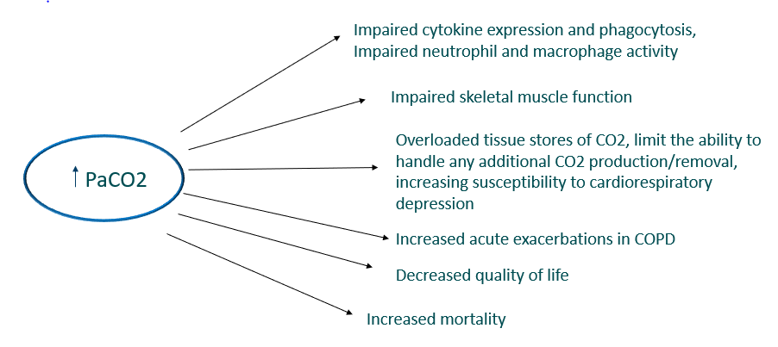
Is Chronic Hypercapnia Bad?!
-Wilson MW, et al. Ann Am Thorac Soc. 2021;18(12):2027-2032 -Jimenez JV, et al. Respiratory Care, May, 2023
-Gates KL, et al. Am J Respir Cell Mol Biol. 2013;49(11):821-828 -Giosa L, et al. Am J Respir Crit Care Med. 2021; 203(3):318-327

Slide 18
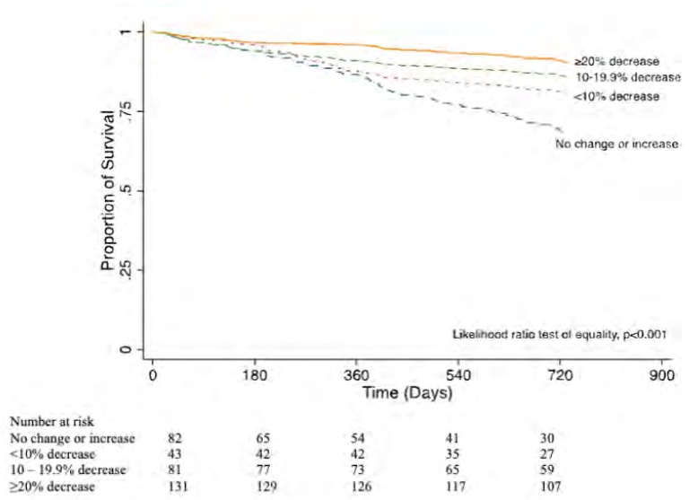
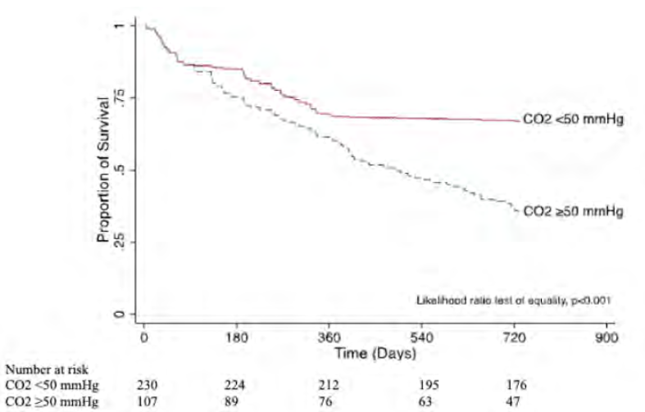
Lowering PCO2 with Non-invasive Ventilation is Associated with Improved Survival in a mixed cohort of Chronic Hypercapnic Respiratory Failure (N=337)
Two-year survival by percent reduction (>20%) or absolute reduction (< 50 mmHg) in PCO2 for the entire cohort of subjects.
The model was adjusted for age, sex, body mass index, race, Charlson comorbidity index, primary diagnosis, and initial PCO2 . Likelihood ratio test of equality, P≤.001.
Jose Victor Jimenez, Jason Ackrivo, Hansen-Flaschen, Choi, et al. RC May, 2023
Notes:
A reduction in PCO2 to < 50 by 3-6 months, was associated with improved survival, and the benefit continued to widen between the two groups overtime.

Slide 19
Outline
Basics of Ventilation control and hypoventilation
Sleep impact on normal respiratory physiology
Consequences of Chronic hypercapnia
Basics of Chronic Non-invasive Positive Pressure Ventilation (NIPPV)
Sleep Disordered Breathing (SDB), Chronic hypercapnic respiratory failure; and NIPPV in special patient populations:
    Obesity Hypoventilation Syndrome (OHS).
    Neuromuscular disease (NMD).
    Stable hypercapnic COPD.

Slide 20
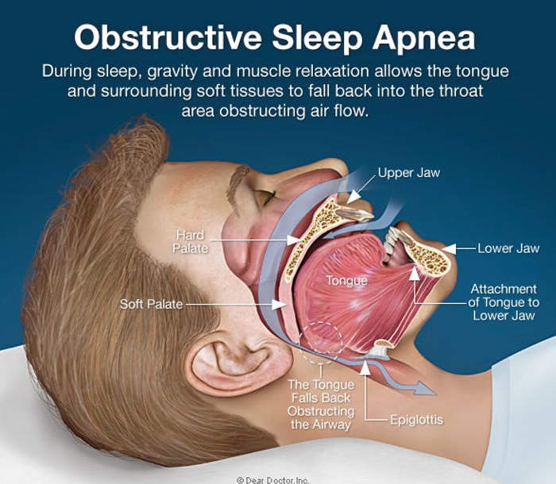
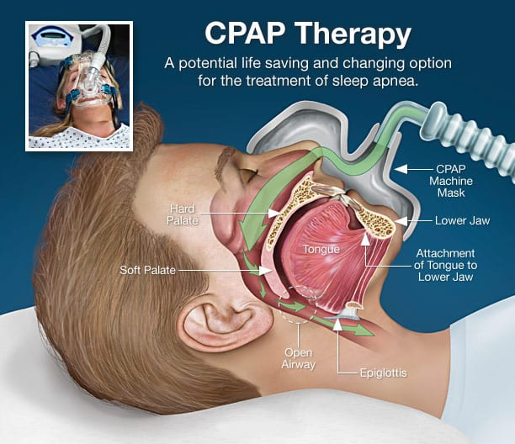
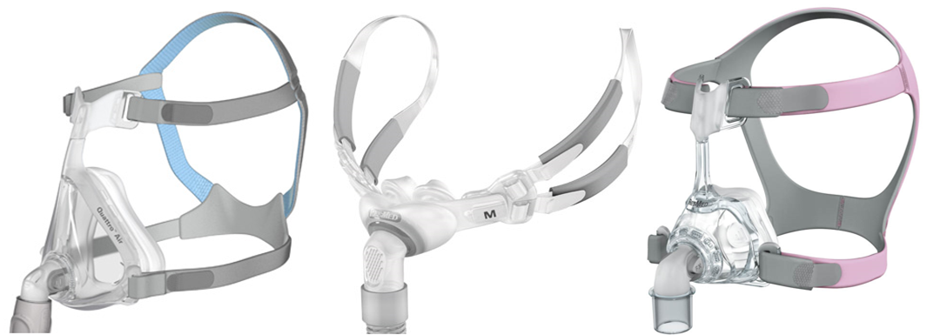
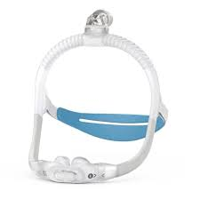
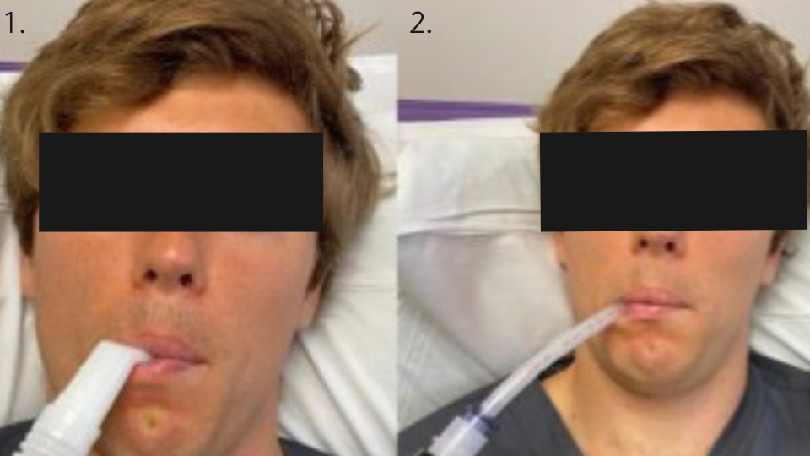
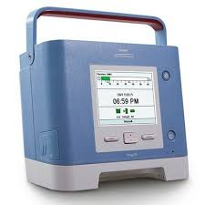
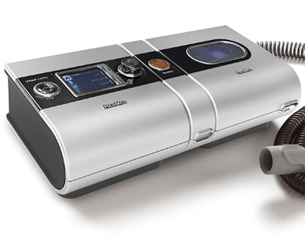
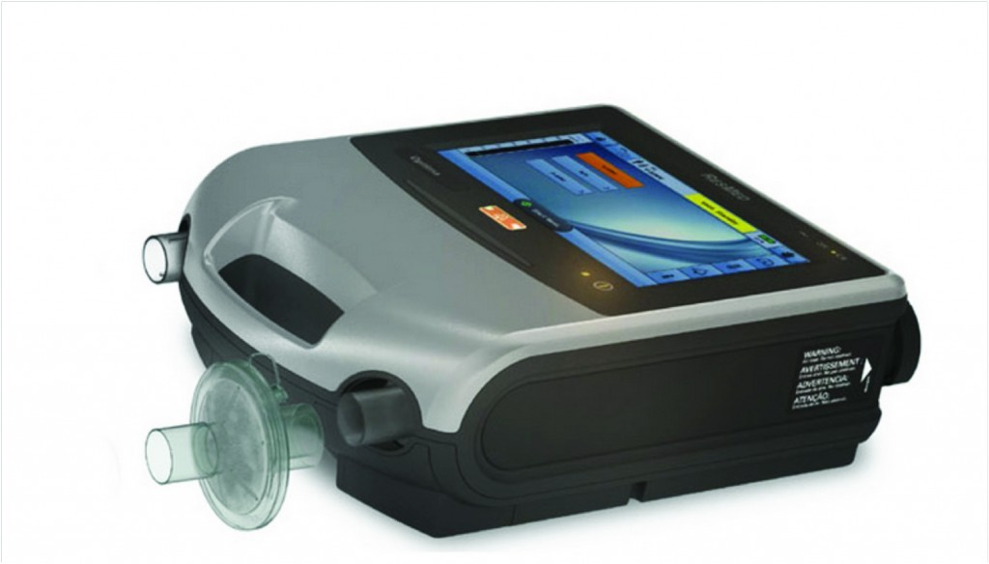
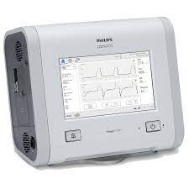
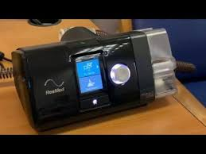
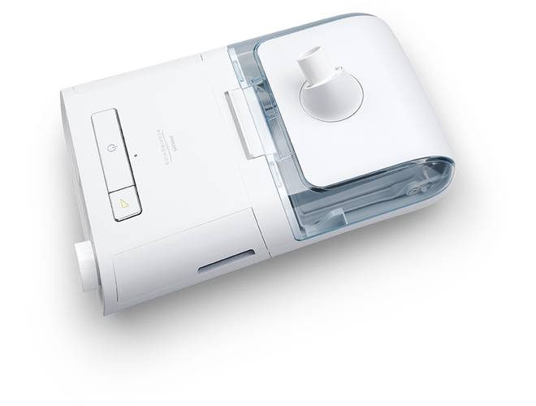
Non-invasive Positive Pressure Ventilation
Respiratory Assist Devices
Home Mechanical Ventilators

Slide 21
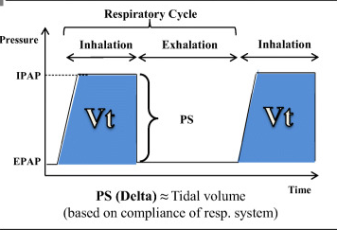
Basic Bilevel Positive Airway Pressure
(All NIV is BPAP)
Selim et al, Neurotherapeutics (2021) 18:81–90
Notes:
All non-invasive ventilation is Bilevel Positive Airway Pressure (BPAP) i.e. pressure modes of ventilation • Different modes are preferred for different indications • Understanding the breath types within each mode helps you understand how to initiate NIV appropriately.

Slide 22
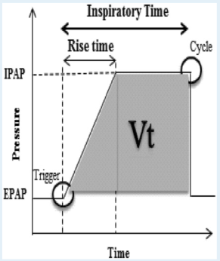
Anatomy of a Pressure Wave Form
Trigger sensitivity
-flow triggered or pressure triggered
Rise time–time from trigger to IPAP for that breath
Cycle point: point at which inhalation switches to exhalation (% of peak flow)
Ti time
-Time from trigger to cycle point
Selim et al. CHEST 2018; 153(1):251-265
Notes:
Apart from PS, Ti is the main setting
driving the size of the exhaled VT. Ti may either apply
to mandatory breaths (Respironics) or to spontaneous
(S) as well as mandatory breaths (ResMed) in
ST mode
cycle is
determined by the percentage of peak flow, the lower
it is set, the later the inhalation supported by IPAP

Slide 23
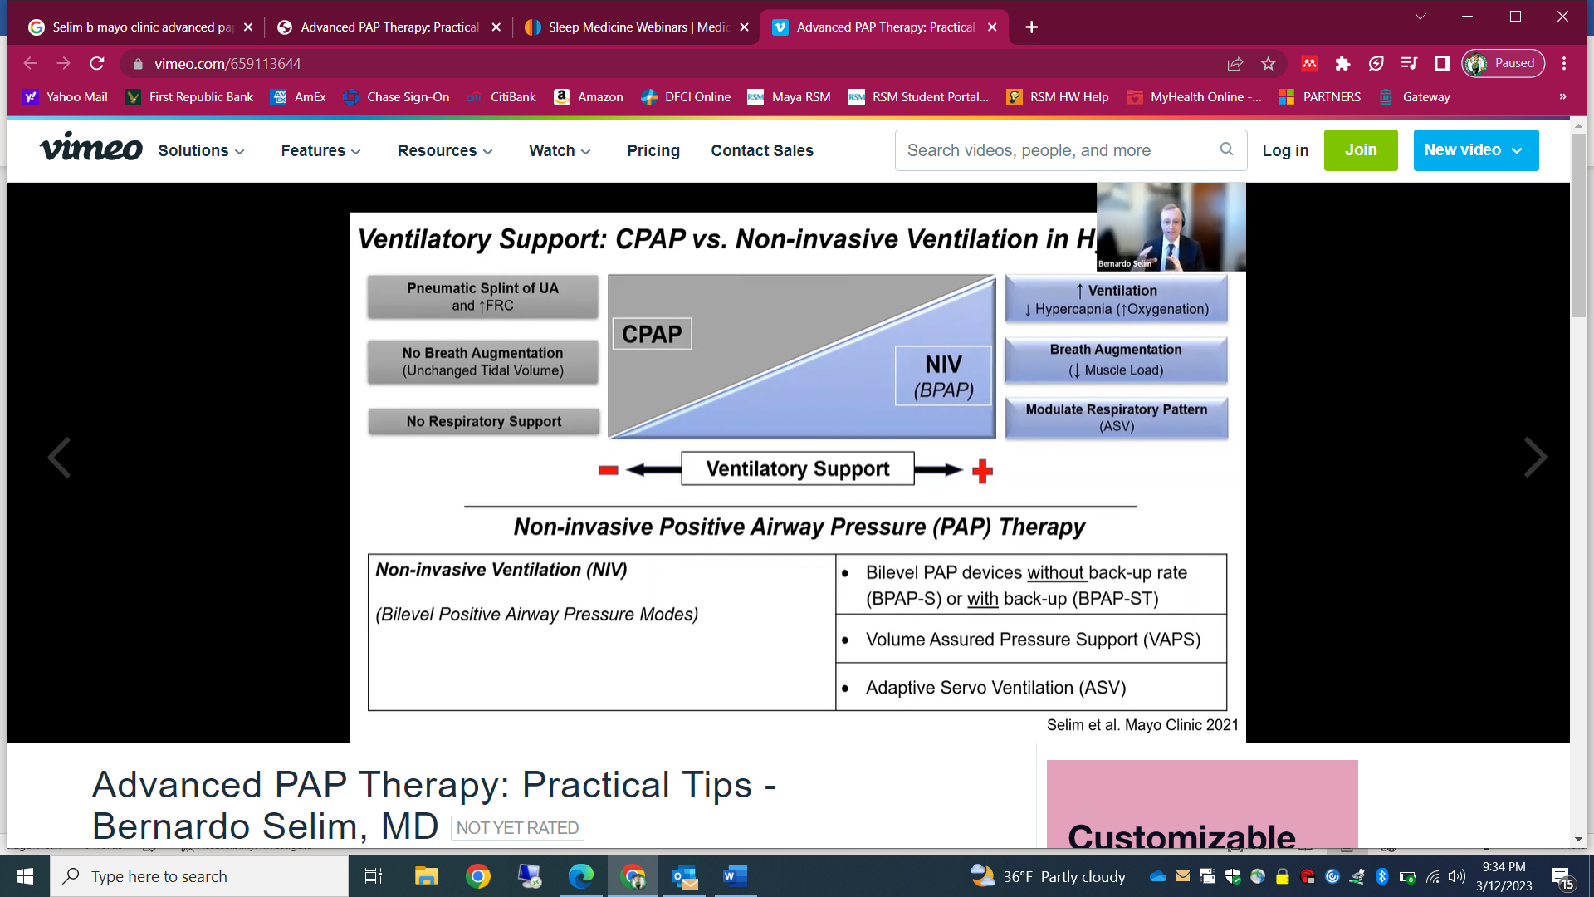
Ventilatory Support: CPAP vs. NIV
Selim et al. Mayo Clinic 2019

Slide 24
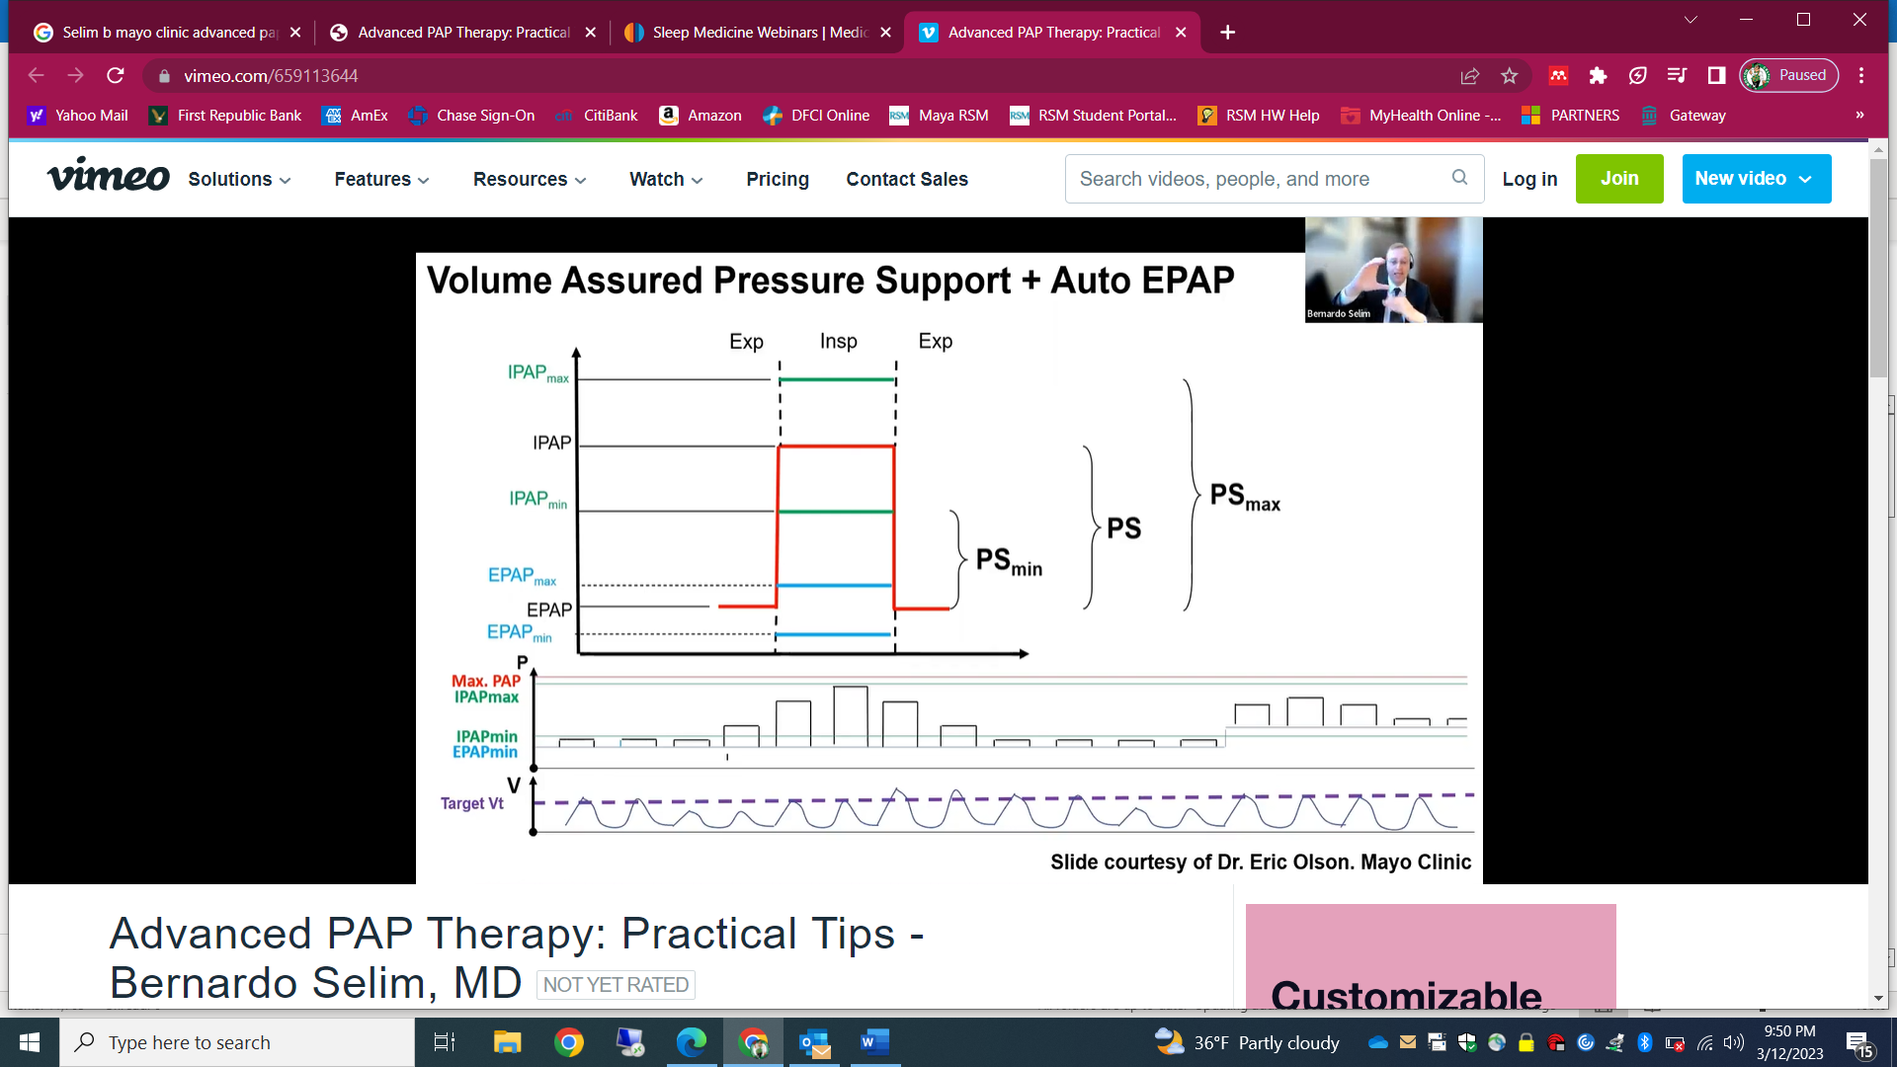
Volume Assured Pressure Support (VAPS)
Eric Olson,. Mayo Clinic

Slide 25
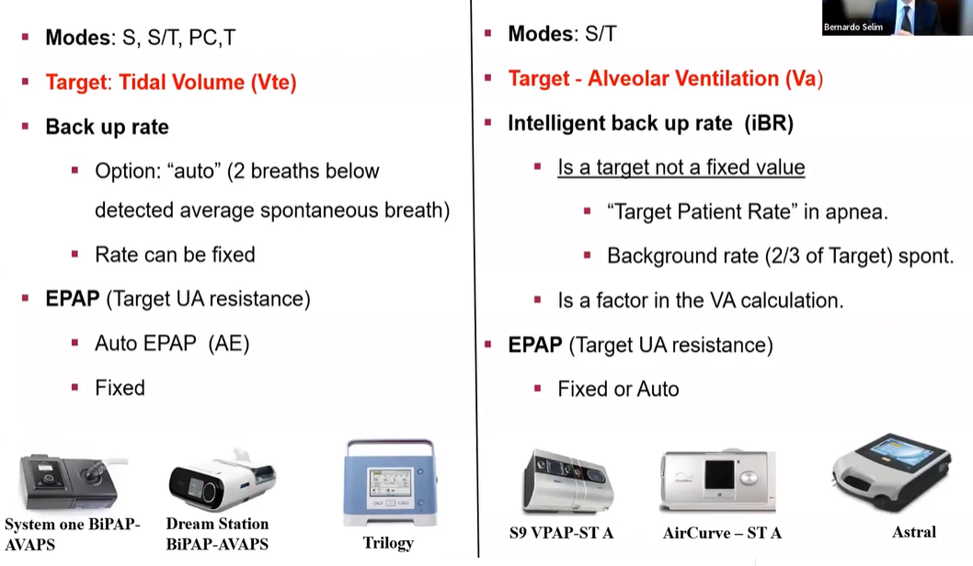
AVAPS vs iVAPS

Slide 26
Non-Invasive Ventilation
Respiratory Assist Devices (RAD) (E0470/E0471) | Home mechanical ventilation (HMV) (E0465/E0466)
Bi-level devices with or without back up respiratory rate capability | Life supporting/sustaining devices
BIPAP-S (E0470) BIPAP-ST/ASV/VAPS (E0471) | Invasive: trach (E0465), Non-invasive: (E0466) Trilogy, Astral
Limited settings | At least 6 pressure modes and 3 volume modes
External batteries optional | Internal (6-18 hours) and external batteries
Only oronasal masks | Can switch between a mouthpiece and oronasal mask
Limited alarms | More sophisticated monitoring and alarm system
Limited payments -- ”rent to own” | Monthly rental for life
Notes:
CPAP is E0601
Codes are from healthcare common procedure coding system (HCPCS codes)

Slide 27
Home Mechanical Ventilators - Comparison Chart

Slide 28
Outline
Basics of Ventilation control and hypoventilation
Sleep impact on normal respiratory physiology
Chronic hypercapnia
Basics of Non-invasive Positive Pressure Ventilation (NIPPV)
Sleep Disordered Breathing (SDB), Chronic hypercapnic respiratory failure; and NIPPV in special patient populations:
    Obesity Hypoventilation Syndrome (OHS).
    Neuromuscular disease (NMD).
    Stable hypercapnic COPD.

Slide 29
Obesity Hypoventilation Syndrome
(OHS)

Slide 30
Definition
Obesity (BMI >30 kg/m²)
Awake arterial PaCO2 > 45 mmHg
No alternative neuromuscular, mechanical or metabolic explanation for hypoventilation
Mokhlesi et al Proc Am Thorac Soc 2008; 5: 218–225.

Slide 31
OHS Phenotypes
Obstructive:
  90% of patients with OHS have OSA (AHI ⩾5/hr).
  70% of patients have concomitant severe OSA (AHI ⩾30/hr)
Non-obstructive:
  10% have non-obstructive sleep hypoventilation (etPCO2 or tcPCO2 >55 mmHg for >10 min or an increase >10 mmHg compared to awake PaCO2 to a value >50 mmHg for >10 min)
Masa et al. Am J Respir Crit Care Med 2015. Berry et al. J Clin Sleep Med 2012

Slide 32
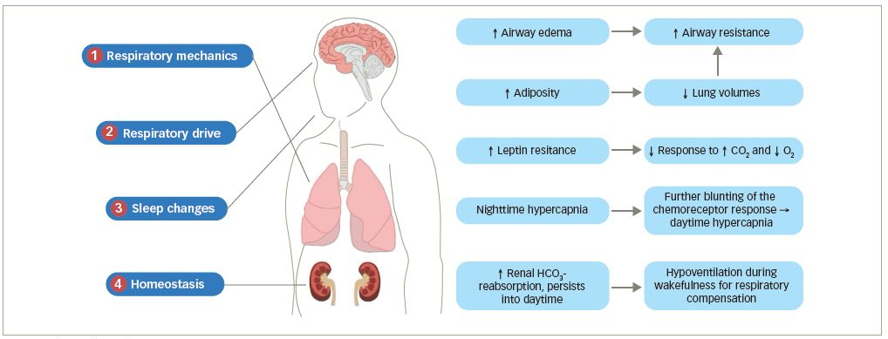
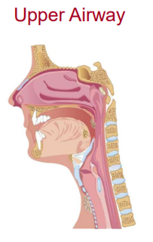
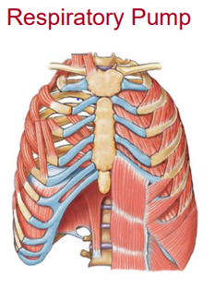
Pathophysiology
Greer et al. US Respiratory and Pulmonary Diseases. 2020
Notes:
Pathophysiology of obesity hypoventilation syndrome (OHS). The implicated mechanisms leading to daytime hypercapnia are, potentially, the obesity-related changes in the respiratory system, central hypoventilation, obstructive sleep apnoeas and hypoventilation during sleep, mainly during rapid eye movement (REM). PEEPi: intrinsic positive end-expiratory pressure; PaO2: arterial oxygen tension; FRC: functional residual capacity; ERV: expiratory reserve volume; RV: residual volume; TLC: total lung capacity.

Slide 33
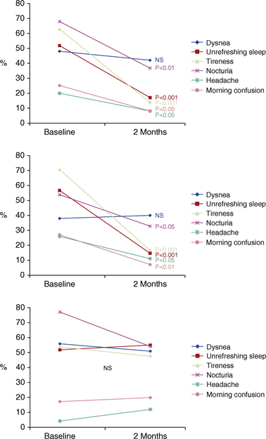
Efficacy of Different Treatment Alternatives for OHS + Severe OSA
Pickwick Study (N=221)
NIV
CPAP
Control
Masa et al. AJRCCM Vol 192;1,July 1 2015
Notes:
Short term, 2 months

Slide 34
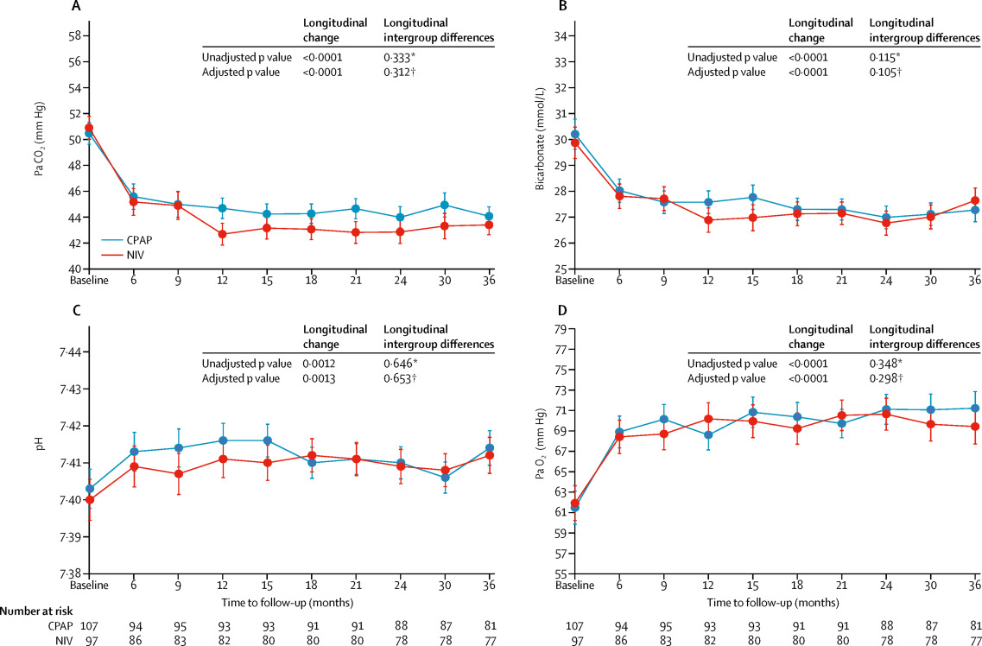
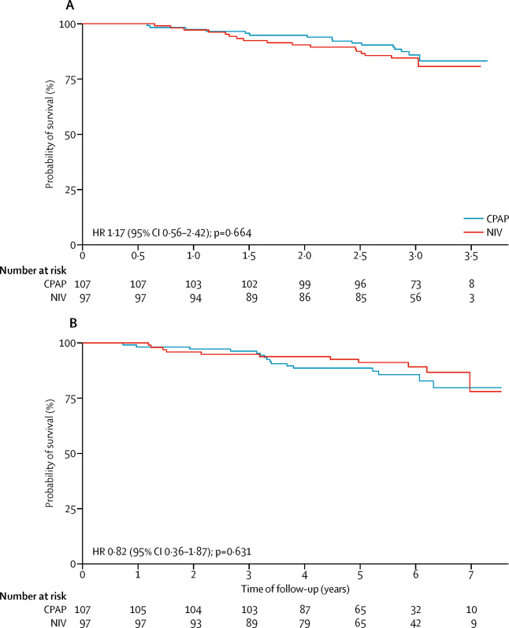
Long-term Effectiveness of CPAP vs NIV in OHS + Severe OSA
Long-Term Pickwick Randomized Controlled Clinical Trial (N=221)
Cardiovascular events
Overall Mortality
Masa et al. The Lancet, Vol 393, issue 10182, page 17215. Apr 27, 2019

Slide 35
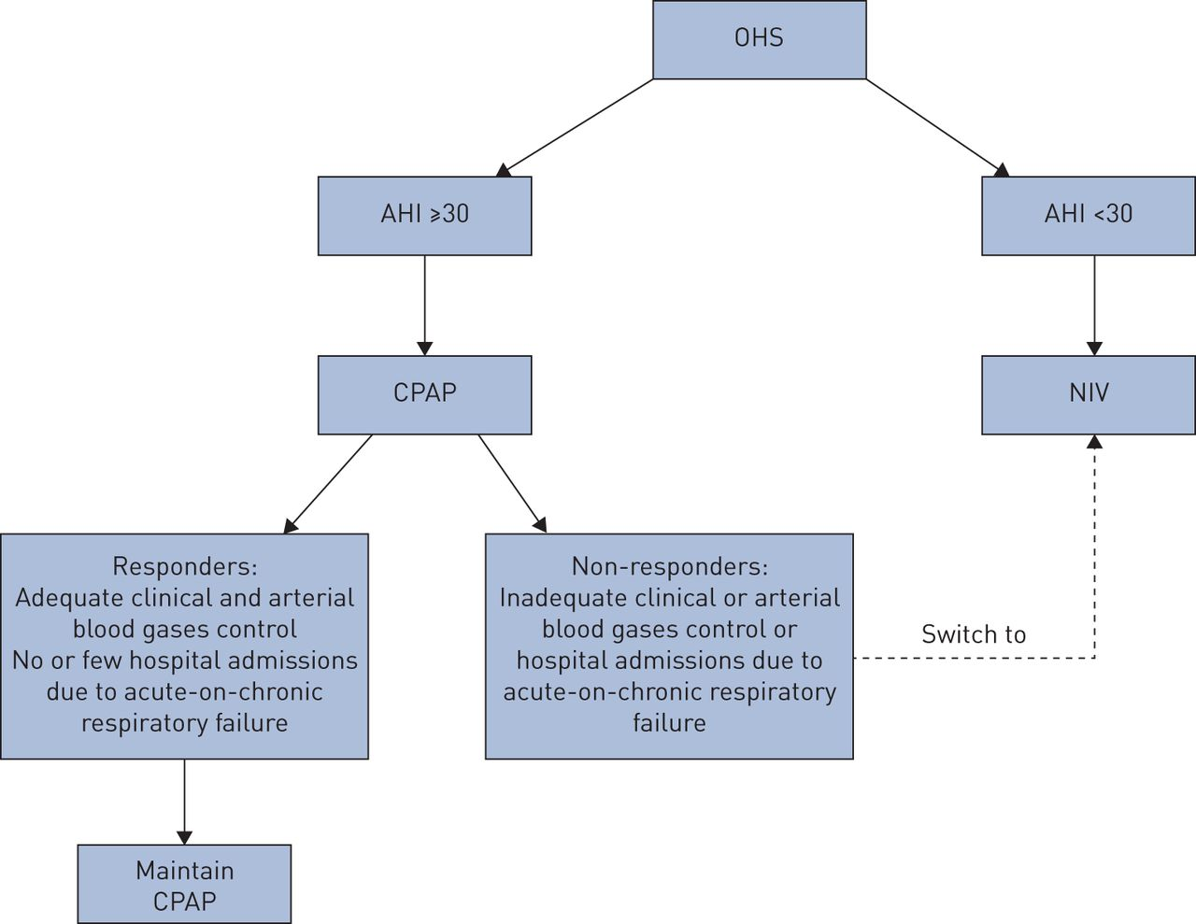
Choice of Positive Pressure Ventilation
Masa et al. Eur Respir Rev 2019
Notes:
Obesity hypoventilation syndrome (OHS) management strategy. Continuous positive airway pressure (CPAP) could be first-line treatment for OHS patients with concomitant severe obstructive sleep apnoea (OSA). Noninvasive ventilation (NIV) should be considered as first-line therapy for OHS patients with no OSA or milder forms of OSA. If patients initially treated with CPAP have no favourable response to therapy despite objectively documented high levels of adherence to CPAP, they should be changed to NIV therapy. AHI: apnoea–hypopnoea index.

Slide 36
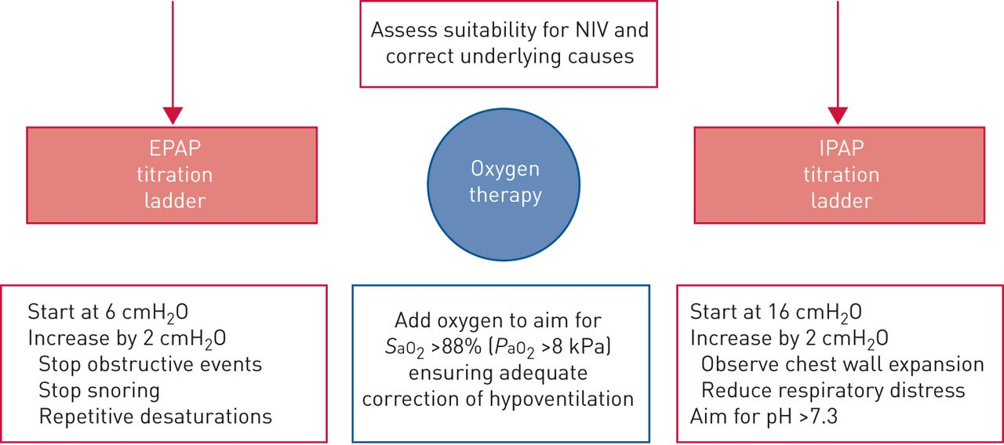
Management - NIV
Masa et al. Eur Respir Rev 2019
Notes:
Positive airway pressure adjustment in acute decompensated obesity-related respiratory failure. The adjustment of continuous positive airway pressure/expiratory positive airway pressure (EPAP) has the objective of eliminating obstructive events, snoring and intermittent oxygen desaturations. Adjustments in inspiratory positive airway pressure (IPAP) are aimed at eliminating hypoventilation and sustained hypoxaemia. For both EPAP and IPAP, the pressure should increase progressively until attaining the objectives (resolution of upper airway obstructive events and sleep hypoventilation) or until the maximal tolerated pressure is reached. Alternatively, EPAP/continuous positive airway pressure can be adjusted to eliminate obstructive apnoeas and IPAP can be further increased to eliminate obstructive hyponoeas, snoring and hypoventilation. With this strategy, the patient may require lower EPAP and therefore achieve higher levels of pressure support in order to improve hypoventilation [96]. Supplemental oxygen is habitually added to positive airway pressure therapy when an adequate oxygenation level is not achieved despite adequate titration of positive airway pressure therapy. NIV: noninvasive ventilation; P_{aO2}: arterial oxygen tension; S_{aO2}: arterial oxygen saturation.

Slide 37
Question #1
A 52 year old man, with a BMI of 45 kg/m², admitted with pneumonia, and acute on chronic hypercapnia. Admission PaCO2 was 75 mmHg, with a pH 7.25 and HCO3 34.
Intubated for three days but now extubated and successfully treated with BiPAP 16/8 cmH2O only during sleep.
Morning PaCO2 now 50 mmHg, with a normal pH.
An ABG following a night without NIV showed a PaCO2 60.
You are contemplating initiation of home NIV.
The patient is all ready for discharge, what should you do?

Slide 38
Question #1
A. Use the patient’s diagnosis and ABG results to qualify for NIV, and order an outpatient attended PSG in 2-3 months.
B. Keep the patient one more night and get a portable sleep study off NIV.
C. Keep the patient one more night and obtain bedside Spirometry.
D. Discharge the patient without NIV and obtain a PSG as soon as you can.

Slide 39
Question #1
A. Use the patient’s diagnosis and ABG results to qualify for NIV, and order an outpatient attended PSG in 2-3 months.
(patient already meets criteria for OHS)
B. Keep the patient one more night and get a portable sleep study off NIV
C. Keep the patient one more night and obtain bedside Spirometry.
D. Discharge the patient without NIV and obtain a PSG as soon as you can.

Slide 40
Months after diagnosis
Benefit of Initiation upon discharge
6% mortality
23% mortality
Nowbar S, et al., Am J Med 2004;116:1–7. Budweiser et al. J Intern Med 2007;261:375–383
Mokhlesi et al. ATS Clinical Practice Guideline. AJRCCM Vol 200, Iss 3, pp e6–e24, Aug 1, 2019
Notes:
Mortality benefit (6% vs 17% at 3 months post-hospitalization)
No RCTs have addressed this question, but
one observational study reported a
mortality of 23% at 18 months in patients
discharged from the hospital without PAP
(23). In contrast, in another observational
study in which all patients were
discharged on NIV, the 2-year mortality
rate was 8% (24).

Slide 41
Neuromuscular Disease
(NMD)

Slide 42
Neuromuscular Disease
Brain/Spinal Cord
  Multiple Sclerosis (transient, migratory)
  Trauma (permanent)
Motor Neuron
  Post-polio syndrome (very slowly progressive)
  Amyotrophic lateral sclerosis (rapidly progressive)
  Spinal muscular atrophy (progressive)
Motor Nerves
  Charcot-Marie-Tooth disease (very slowly progressive)
  Diaphragm paralysis (slowly reversible)
Neuromuscular Junction
  Myasthenia gravis (reversible)
Muscle
  Duchenne muscular dystrophy (slowly progressive)
  Myotonic dystrophy (progressive)
  Metabolic: acid maltase deficiency (slowly progressive)

Slide 43
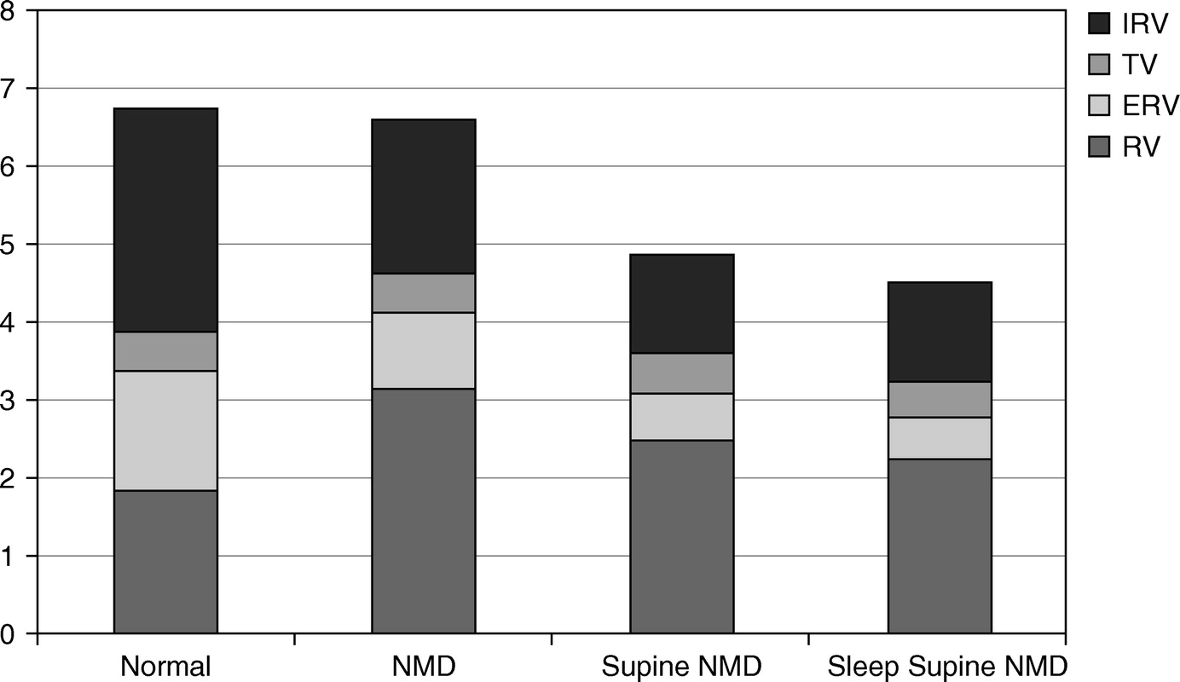
Neuromuscular Disease and respiratory pathophysiology
Aboussouan et al. AJRCCM Vol 191, Iss 9, pp 979–989, May 1, 2015
Notes:
Comparison of individual lung volumes in normal subjects versus subjects with neuromuscular disease (NMD). Normal: Baseline lung volumes for a 45-year-old man, weight 68 kg and height 175 cm. NMD: Reduced vital capacity from an increase in residual volume (RV) and to a lesser extent from a decrease in the total lung capacity. The functional residual capacity is preserved to slightly increased, but the expiratory reserve volume (ERV) is reduced. Supine with NMD: Decreased functional residual capacity and ERV, and reduced vital capacity and total lung capacity. Supine sleep with NMD: Functional residual capacity is further reduced, and there is a decrease in the tidal volume (TV). IRV = inspiratory reserve volume.

Slide 44
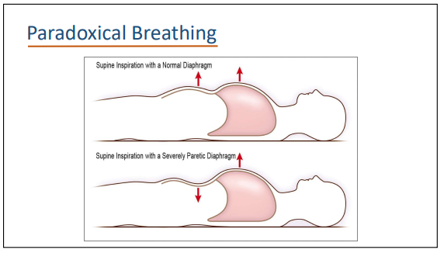
Diaphragmatic Weakness/Paralysis
John Hansen-Flaschen, MD, Penn Medicine

Slide 45
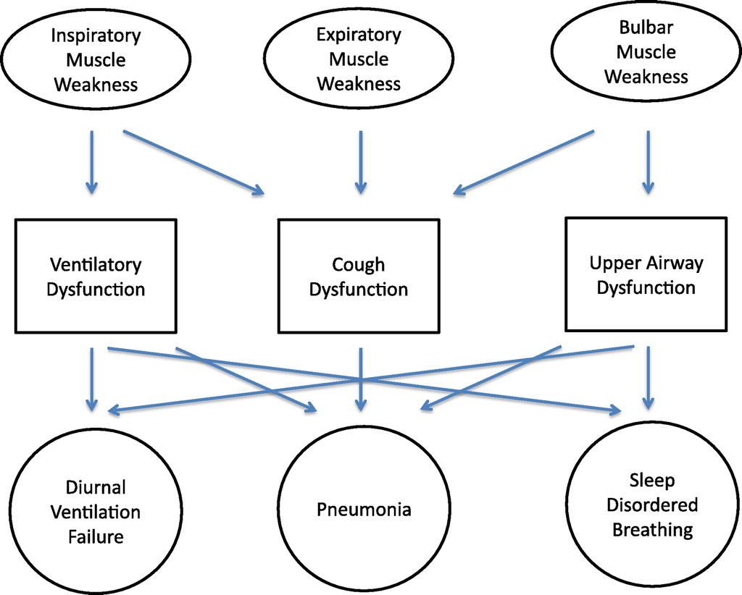
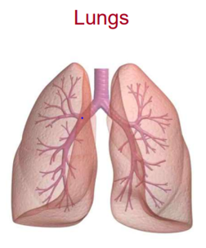
Neuromuscular Disease and respiratory pathophysiology
Benditt et al. AJRCCM Vol 187, Iss. 10, pp 1046–1055, May 15, 2013

Slide 46
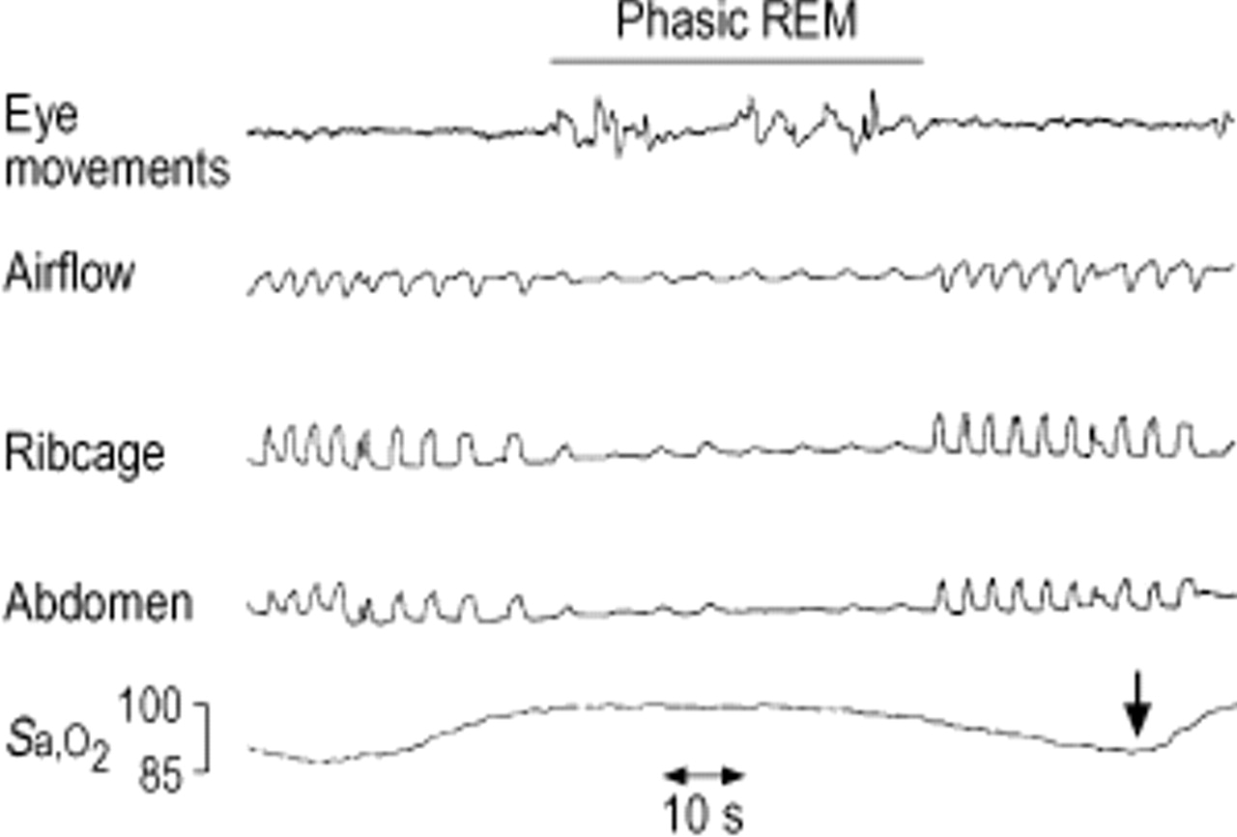
Diaphragmatic Events
Bourke et al. Eur Respir J 2002; 19: 1194–1201
Notes:
Diaphragmatic events reflect hypopneas that
are neither obstructive nor central but rather due to
diaphragm weakness, and they are generally timed to
phasic REM sleep (ie, during bursts of eye movements)
(Fig 1). When REM atonia is compounded by
diaphragm dysfunction, there may be a complete loss of
excursion of both chest and abdominal signals on
polysomnography, appearing as pseudo-central events.
Suppression of airflow, chest and abdominal movement during tonic and phasic rapid eye movement (REM). Phasic REM is identified by the burst of rapid eye movements, and indicated by a bar. The consequent reduction in the arterial oxygen saturation (Sa,O2) is indicated by the arrow.

Slide 47
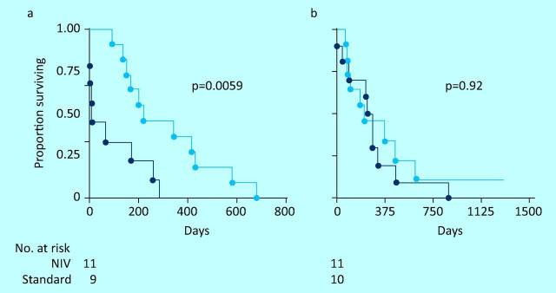
Survival Benefit of NIV in ALS
RCT (N=41)
Survival non-invasive ventilation (blue) compared with standard care (black) in patients with ALS and (a) normal or only moderately impaired bulbar function and (b) severe bulbar impairment.
Bourke et al. Lancet Neurol. 2006 Feb; 5(2):140-7.
Notes:
The only randomized controlled trial (RCT) of noninvasive
ventilation (NIV) with survival as a primary outcome was
published by Bourke et al in 2006.19 They screened 121
patients and ultimately recruited 92 patients to be followed
every two months until randomization, which occurred if
they met one or both of the pre-defined criteria: orthopnea
with Peak inspiratory pressure (PImax) less than 60% predicted
or symptomatic daytime hypercapnia. Ultimately, 41
were randomized and the data analyzed for all patients and
also subdivided into “better” or “poor” bulbar function. All
patients using NIV showed a modest survival advantage from
randomization to death over those patients randomized to
standard care excluding NIV: 219 (range 75–1382) days vs
171 (1–878) days. The subgroup with “better” bulbar function
showed a much larger survival advantage with NIV compared
to controls: 216 (range 94–681) days vs. 11 (1–283) days.
There were six deaths of nine patients in the control group
with better bulbar function within two weeks of enrollment.
Five of the six had severe respiratory muscle weakness at
enrollment. The “poor” bulbar function group showed
improvement in health-related quality of life (HRQoL) if
receiving NIV, but no survival benefit: 222 (range 75–1382)
days vs 261 (6–878) days. The mean duration of daily use in
this group, however, was less than four hours. In addition,
the numbers were small and not powered to show survival
benefit in the subgroup with poor bulbar function.

Slide 48
Identifying who will benefit from NIV in ALS/MND in a clinical cohort
Retrospective study (N=929)
Patients who refused NIV were taken into the control group
The NIV group had a 13 months survival benefit (including patients with poor bulbar function)
NIV delayed deterioration of respiratory function (FEV1, FVC, MIP/MEP, Sniff nasal insp pressure-SNIP)
Quality of life questionnaires and Sleep quality questionnaires also showed improvement.
Berlowitz DJ, et al. J Neurol Neurosurg Psychiatry 2016;87:280–286
Notes:
In contrast with the only randomised controlled trial, NIV statistically significantly increased survival by 19 months in those with ALS-bulbar onset (Univariate HR=0.50 (0.36 to 0.70), multivariate HR=0.59 (0.41 to 0.83)). These data confirm that NIV improves survival in MND/ALS. The overall magnitude of benefit is 13 months and was largest in those with ALS-bulbar disease.

Slide 49
Initiating NIV
When? FVC < 50%, MIP < 60 cmH2O, PaCO2 > 45 mmHg, ? Symptoms
Where? During in-patient admission, outpatient setting or sleep lab
BPAP-ST | VAPS (iVAPs or AVAPS)
IPAP: 8-10 cmH2O EPAP: 4-5 cmH2O BR: 2 below spont RR Adjust IPAP by 1-2 cmH2O to alleviate dyspnea, decrease RR, and increase tidal volume | EPAP: 4-5 cmH2O IPAP min: 4-6 cmH2O, gradually increase to reach target tidal volume of 8 ml/kg IPAP max: IPAP min + 5-6 cmH2O BR: 2 below spont RR Adjust trigger sensitivity, rise time, inspiratory time, to alleviate dyspnea and patient comfort
Follow downloaded data, monitor for symptoms, overnight oximetry/TcCO2, VBG or HCO3. PSG only if patient can’t adapt or you suspect OSA.
If daytime ventilation becomes necessary, consider mouthpiece ventilation rather than tracheostomy (Switch to HMV if not already initiated)
ACCP Clinical Practice Guideline and Expert Panel Report. Khan et al. CHEST. 3/13/2023;164(2):394-413
Notes:
There is a lack of consensus on whether and how to monitor gas exchange during initiation. Transcutaneous CO₂ monitoring systems with oximetry may be helpful if available. End-tidal partial pressure of carbon dioxide (P_{ET}CO₂) measurements via the mask are less reliable because of leaks and dilution of expired gas causing underestimation of actual PaCO₂. Arterial blood gases are less often done but venous blood gases are obtained in some settings. Evidence is lacking on how to apply this information, but choosing settings to reduce PCO₂, perhaps by 5 mmHg in hypercapnic patients may be helpful to assure augmentation of ventilation.
Nasal masks can be problematic in bulbar patients, since ventilation air might escape due to incomplete closure of the mouth, especially at night during sleep. On the other hand, nasal masks are generally better tolerated and allow easier communication compared with full-face masks covering mouth and nose. Both types of mask can lead to facial pressure ulcers, which may limit their application, and necessitate the use of total full-face masks that cover the whole face but have the disadvantage of greater dead space and leakage.
In patients with functioning mouth muscles, daytime mouthpiece ventilation may be beneficial due to the reduced risk of facial pressure ulcers as well as enhanced speech and swallowing
progression of disease (eg, percentage of breaths spontaneously triggered and cycled). Although NIV has the capability
of meeting a desired targeted VT, whether this is
appropriate for the patient’s ventilation needs will need
to be assessed separately. A finding of a rising total
respiratory rate or an increasing assisted rapid shallow
breathing index may suggest an ineffective level of
respiratory support.
As NMD is progressive, there comes a time at which
nocturnal support is not enough, and patients will
require daytime ventilation support. A home mechanical
ventilator with internal battery and portability can be
used with mask ventilation or mouthpiece/sip
ventilation or through a tracheostomy. Mouthpiece or
sip ventilation allows a patient to take ventilatory
support as needed, usually through a straw or angled
mouth piece. When a patient requires full ventilatory
support 24 hours a day, tracheostomy is not a
mandatory requirement, unless there are additional
issues with the inability to clear secretions or mental
status changes. Long-term use of 24-hour NIV has now
been reported by several authors.

Slide 50
Question # 2
A 57 year old man with ALS, admitted with pneumonia, acute on chronic hypercapnia.
Admission PaCO2 was 75 mmHg, pH 7.25 and HCO3 34
Intubated for 5 days but now extubated and successfully treated with BiPAP 15/5 cmH2O during sleep.
Morning PaCO2 now is 50 mmHg with a normal pH, and the patient is much more comfortable with more daytime energy.
A bedside spirometry showed an FVC 40% predicted.
You are contemplating sending this patient home on NIV.
The patient is all ready for discharge, what should you do?

Slide 51
Question # 2
A. Use the patient’s current diagnosis and ABG results to qualify for NIV
B. Keep the patient one more night and get a portable sleep study off NIV
C. Discharge the patient without NIV and get the PSG as soon as you can
D. Obtain an outpatient full PFTs with seated/supine spirometry to qualify for NIV.

Slide 52
Question # 2
A. Use the patient’s current diagnosis and ABG results to qualify for NIV
(Patient already meets criteria for initiation of NIV in ALS)
B. Keep the patient one more night and get a portable sleep study off NIV
C. Discharge the patient without NIV and get the PSG as soon as you can
D. Obtain an outpatient full PFTs with seated/supine spirometry to qualify for NIV.

Slide 53
Stable Hypercapnic COPD

Slide 54
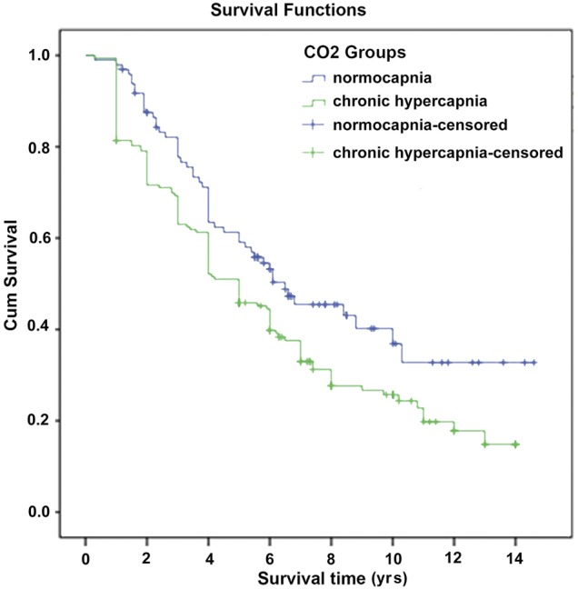
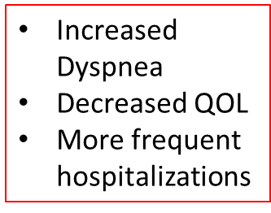
Hypercapnia in COPD and Survival
(p=0.016)
Yang H. et al. BMJ Open 2015;5:e008909
Notes:
Figure 3 Comparison of survival curves in all patients between groups with normocapnia and chronic hypercapnia (p=0.016).

Slide 55
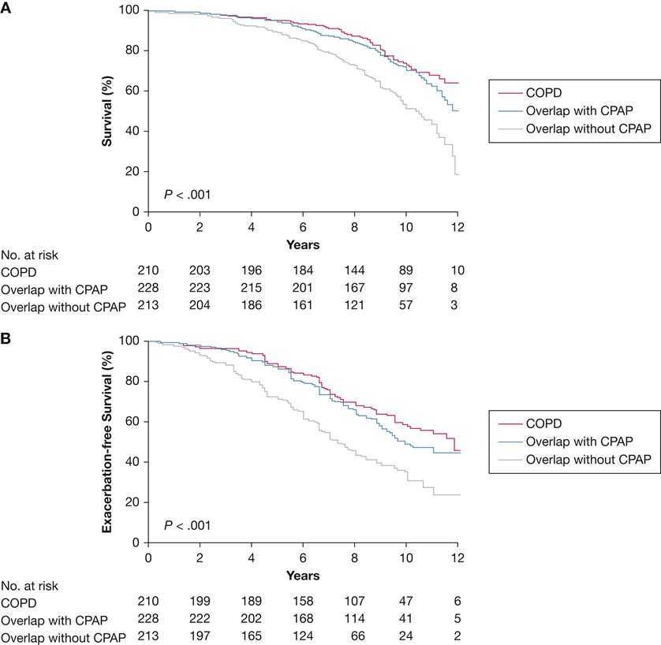
Overlap Syndrome - ↑ Mortality
(COPD + OSA, Prevalence = 29%)
Marin J.M. et al. Am J Respir Crit Care Med. 2010; 182: 325-331
Notes:
Kaplan-Meier survival curves : A, Percentage survival and (B) percentage of severe COPD exacerbation-free survival curves among the three study groups. The differences between COPD alone and COPD with OSA treated with CPAP are statistically significant from patients with COPD and untreated OSA (P < .001).

Slide 56
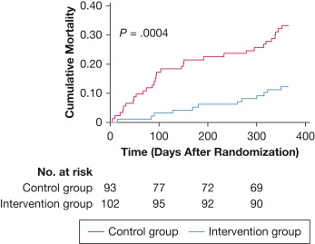
High Intensity BIPAP for COPD with Chronic Hypercapnia
Long Term RCT (N = 201): COPD Gold IV (PaCO2 > 52 and pH > 7.35, stable hypercapnic)
  HI NIV (IPAP 24-28 cmH2O with back up rate) aimed to reduce PaCO2 to below 48, or >20% from baseline, vs standard of care for the control group (home oxygen)
  Improved 1 year mortality (p=0.0004)
  Improved PaCO2, pH, SaO2, FEV1 and HRQOL with HI NIV
33%
12%
Kohnlein, T et al Lancet Respir Med 2014
Notes:
Short term RCT 6 wks crossover (N=17)
(HI with mean IPAP 28 vs. LI mean IPAP 14)
Only in the HI gp, there was increased use of NIV, reduced PaCO2 (mean 9 mmHg), improved lung function and QOL
Conversely, in those patients with severe COPD in compensated hypercapnic
respiratory failure without OSA, the usual BPAP therapy
(low PS) has proved ineffective (low-intensity
BPAP).33-36 In this population, emerging literature
supports benefits from high-intensity therapy, with high
IPAP/PS adjusted to achieve total control of the patient’s
spontaneous breathing, with near abolition of
diaphragmatic activity.37 In these studies, not yet
replicated in the United States, PS (and respiration rate
[RR]) were adjusted to decrease arterial tension CO2 by
20% or to achieve a value lower than 48 mm Hg by
reaching IPAP > 18 cm H2O, achieving mortality
improvement without affecting sleep quality38-40

Slide 57
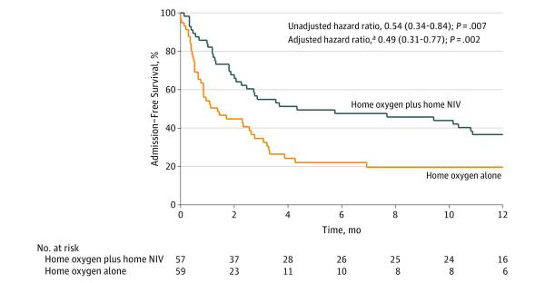
When to Initiate Home NIV in Hospitalized Patients?
  The Rescue trial (N=201)
    Patients with persistent hypercapnia at 48 hrs, assigned to NIV vs standard of care
    At 1 year, NO reduction in mortality or frequency of exacerbations or time to readmission
    Patients recruited right after exacerbation, many did not have persistent hypercapnia
    The Home Oxygen Therapy-Home Mechanical Ventilation Trial
    HOT-HMV trial (N=116)
      Patients with persistent hypercapnia (PaCO2 > 52) at 2-4 weeks post discharge were assigned to HOT-HMV or HOT alone.
      Median HMV settings: IPAP 24 cmH2O, EPAP 4 cmH2O, RR 14/min
      HOT-HMV showed reduction in readmission or death by 50%
ATS recommendation: assess 2-4 weeks post discharge for a PaCO2 > 52, and if present, initiate NIV
Struik et al. Thorax. 2014 Sep; 69(9). Murphy et al. JAMA. 2017 Jun 6; 317(21).
Am J Respir Crit Care Med Vol 202, Iss 4, pp e74–e87, Aug 15, 2020
.
Notes:
The reason The Struik (Rescue trial) showed no difference is that these patients were recruited right after an AECOPD, some patients may not have persistent hypercapnia, and in that trieal they did not have significant hypoxemia (baseline PaO2 60)
In the US, assessment at 2-4 weeks for hypercapnia, and in those with suspicion for OSA, obtain a PSG, otherwise home titration is acceptable

Slide 58
Case Presentation Cont’d
In the ICU our patient with limb-girdle muscle dystrophy responded well to BiPAP, ABG: 7.39/65, bicarb 36
Upon reviewing a download from her home machine:
  Days used 70% of the time
  Average usage: 5 hours a night
  Air leak: high
  Average Tidal volume: 380 ml
Switched her to BiPAP at a setting close to hospital setting that she was comfortable with
Provided a different mask
ABG: 7.43/59, bicarb 34
Adjusted her trigger, rise and cycling

Slide 59
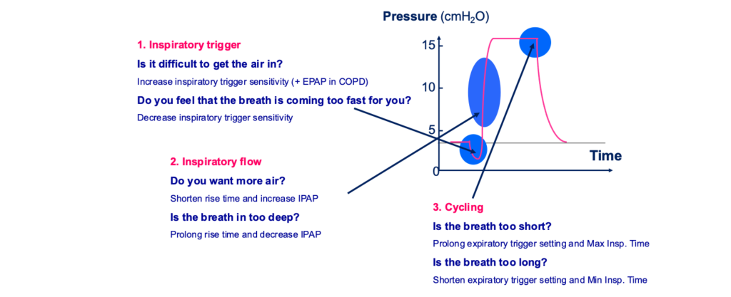
Asynchrony – Practical Tips
Notes:
In some devices, a software product
determines the trigger without the physician needing
to adjust the setting manually (eg, Auto-Trak by
Respironics).20 The use of the standard Auto-Trak
assumes normal diaphragmatic strength; therefore, it
may be associated with premature cycling in patients
with neuromuscular disease (NMD) and trigger
insensitivity in patients with COPD.21 A newer
version of the software (sensitive Auto-Trak) allows
adults with weakness or children to more easily
trigger breaths, although this function has not been
developed or tested in patients with NMD. Clinically,
a highly sensitive trigger (less effort needed to trigger
IPAP) may be used in patients with NMD to improve
Synchrony
Rise time sets the time (in milliseconds) it takes the
device to transition from EPAP to IPAP (pressurization
time). A slower rise can be helpful in those
with bulbar disease or chest wall stiffness. A faster
rise time may be helpful to improve comfort in those
with “air hunger” or muscle weakness
(eg, in NMD it may be set at 8%-
15% or “very low,” and in COPD it can be set at
35% or “very high”). Otherwise, the inhalation supported
by IPAP may terminate by reaching the Ti
limit in an assisted breath (inhalation initiated by
patient but cycled by the device) or a mandatory
breath (inhalation initiated and terminated by the
device). In comparison with the BIPAP device
(Respironics), the VPAP device (ResMed) cycles out
of IPAP in a window period

Slide 60
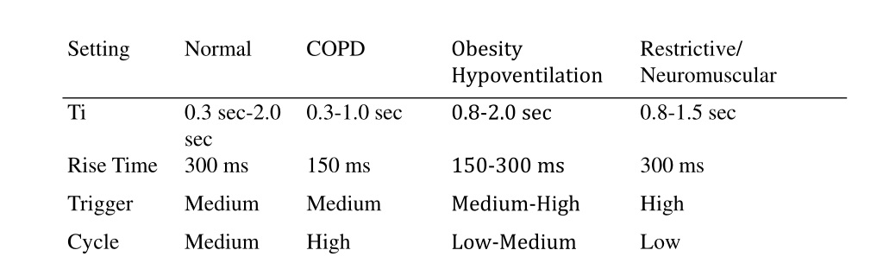
Bilevel Tools – In summary

Slide 61
In Summary
Onset of hypoventilation can be very insidious, and diagnosis is often delayed in the ambulatory setting.
Patients need close follow up and routine screening based on their underlying disease
NIV can be very effective in correcting hypoventilation
VAPS mode of NIV has the benefit of adapting to changes in lung mechanics overtime
NIV has been shown to improve quality of life and mortality in patients with OHS, neuromuscular disease and chronic hypercapnic respiratory failure

Slide 62
In Summary
In patients with OHS, start with CPAP if severe OSA, but if it fails, or if diagnosed while hospitalized, we should trial NIV
Patients with COPD+OSA, should be offered CPAP
Patients with stable hypercapnic COPD (PaCO2 > 52) should be considered for high intensity BiPAP. For inpatients, follow up PaCO2 2-4 weeks post discharge
In patients with NMD, consider starting NIV at the time of diagnosis, if qualifies
We need more robust evidence to answer: When? Where? and What mode of ventilation to choose in specific patient population?
Asynchrony can limit adherence and should be addressed routinely.
Monitor for signs of improved ventilation (increased minute ventilation, decreased transcutaneous CO2, decreased PCO2 on blood gas testing)

Slide 63
References
Evaluation and Management of Obesity Hypoventilation Syndrome:
An Official American Thoracic Society Clinical Practice Guideline.
Am J Respir Crit Care Med Vol 200, Iss 3, pp e6–e24, Aug 1, 2019
Home mechanical ventilation for patients with Amyotrophic Lateral Sclerosis:
A Canadian Thoracic Society clinical practice guideline:
Canadian Journal of Respiratory and Critical Care Medicine, 2019, VOL. 3, NO. 1, 9-27
Practical guide to management of long-term Noninvasive Ventilation for adults with chronic neuromuscular disease
Hansen-Flaschen et al, Respiratory Care, August 2023, 68 (8), 1123-1157
Long-Term Noninvasive Ventilation in Chronic Stable Hypercapnic Chronic Obstructive Pulmonary Disease:
An Official American Thoracic Society Clinical Practice Guideline
Am J Respir Crit Care Med Vol 202, Iss 4, pp e74–e87, Aug 15, 2020

Slide 64
Questions? khismail@bwh.harvard.edu

Slide 65
OHS Qualifying Criteria
  BIPAP
    Awake ABG PaCO2 ≥45 mm Hg on prescribed FIO2, AND
    COPD has been considered and ruled out, AND
    ABG on awakening with PaCO2 ≥7 from baseline, OR
    PSG or HST demonstrates desaturation ≤ 88% for ≥ 5 minutes of recording not due to obstruction (AHI < 5)
  BIPAP-ST/VAPS
    Despite BIPAP-S use, AGB on awakening with PaCO2 ≥7 mmHg from qualifying PaCO2, OR
    PSG or HST on BIPAP-S demonstrates desaturation ≤ 88% without OSA
  HMV
    Persistent Hypercapnia or need for higher IPAP >25 CMW
    Significant dyssynchrony (longer insp time, higher EPAP, adjust rise time)
    Need for daytime support (>10 hrs)

Slide 66
NMD Qualifying Criteria
BIPAP-S, BIPAP-ST/VAPS:
  Diagnosis of progressive neuromuscular disease, AND
  Awake PaCO2 > 45 mmHg while on prescribed FiO2, OR
  Overnight oximetry shows SaO2 ≤ 88% for > 5 minutes (minimum recording of 2 hours) on prescribed FIO2, OR
  Max inspiratory pressure < - 60 cmH2O
  FVC < 50% predicted AND COPD is not contributing to symptoms.
Notes:
PFTs difficult in patients with bulbar disease
Studies have shown early start has better outcome, but no clear guidance

Slide 67
Chronic Hypercapnic COPD Qualifying Criteria
  BIPAP-S
    ABG with PaCO2 ≥52 AND,
    Overnight oxygen desaturation ≤88% on 2 lit oxygen or on patient’s prescribed supplemental oxygen (whichever is higher), for > 5 minutes, AND
    OSA is considered and ruled out (Sleep study not required)
  BIPAP-ST/VAPS
    PaCO2 ≥7 mmHg from baseline, AND persistent overnight desaturation despite use of BIPAP-S, for at least 2 months, average 4 hours per night.
  HMV
    Persistent Hypercapnia despite highest BIPAP-ST support (IPAP >25 CMW)
    Significant dyssynchrony (shorter insp time, adjust rise time)
    Increased oxygen requirement (more than 40% FiO2)
    Need for daytime support (>10 hrs) or the need of a mouthpiece
    OR, Documentation of Chronic respiratory failure secondary to COPD
Notes:
VAPS is indicated in stable hypercapnicCOPD patients (pCO2>52 when stable) and
•Nocturnal hypoxemia (SpO2 <88% x 5 min) or
•Recurrent AE-COPD hospitalizations
•Mortality benefit with NIV less clear
•High intensity ventilation which lowers pCO2 seems to have better outcomes
•VAPS with TV ~ 8cc/kg can be used to try & approxhigh intensity ventilation
•Use short inspiratory times (Timax <1.2 sec)
•AVAPS-AE (ST mode) with AutoTrakis particularly well-suited for COPD pts.
•Severe COPD patients may have intrinsic PEEP so using a bit of EPAP may help overcome inspiratory threshold load

Slide 68
Practical Approach
Does the patient qualify for a RAD?
  Yes -> Start RAD without backup rate in S mode
    Regular visits to adjust mask, settings and target goal daytime PCO2
    Improved daytime symptoms and PCO2
      Yes -> continue and do in home nocturnal testing
      No -> Switch to RAD with backup rate and restart
  No -> Do they have frequent / recurrent hospitalizations for Hypercapnia?
    Yes -> Order for HMV (may be on hospital discharge)
      Regular visits to adjust mask, settings and target goal daytime PCO2
      In home nocturnal testing
    No -> refer for sleep study

